Slide 1
Course Title: Business Communication Workshop
Instructor: Saba Akmal
Course Code: HUM 200
Credit Hours: 3
Semester: Spring 2025 (BSEE, BSCE).
COMSATS University Islamabad Lahore Campus

Slide 2


Business Communication Workshop is a compulsory 3 credit hour course. It is an essential course because effective communication skills are indispensable for business professionals in the highly globalized world of today.
All the time, they are required to communicate in various professional capacities through written, electronic, oral and non-verbal means. As such, strong communication and interpersonal skills are the hallmarks of successful business entrepreneurs.

Slide 3

This course focuses on the ability of students to communicate, with an emphasis on the ability to communicate successfully across cultural boundaries.
Effective communication is a skill, and hence it can be learned. Students will be exposed to theories and concepts that underlie effective oral and written communication skills.
They will learn to collect, organize, analyze and present information in an understandable and logical order; understand the nature of non verbal communication and be able to use it effectively in oral and written presentations.

Slide 4

After completion of this course, students are expected to be able to:
Know the meaning, forms and process of communication
Understand intercultural communication
Understand the importance of non-verbal communication
Read & understand a passage, report, news item etc efficiently
Use appropriate sentence structure
Write paragraphs with proper topic sentences
Listen and understand lectures
Work in pair/group with peers
Write Resume’ & letter
Write informational & analytical reports
Brainstorm on a topic and make its outline
Get familiar with researching
Develop presentation skills

Slide 5

Understanding Business Communication,
Communicating in Teams,
Communicating Interculturally,
7 Cs of Effective Communication,
Effective Sentence structure, Paragraph writing,
Resume’ & Application Letter,
Planning Business Messages,
Composing Business Messages,

Slide 6

Completing Business Messages,
Planning Reports, Writing Business Reports, Completing formal Business Reports,
Writing Good News & Neutral Messages,
Bad News Messages,
Persuasive Written Messages,
Oral Presentations,
Writing emails

Slide 7

Excellence in Business Communication (8th Edition), by John V. Thill, Courtland L. Bovee
Effective Business Communication by Herta Murphy, Herbert W. Hildebrandt, Jane. P. Thomas
Essentials of Business Communication by Mary Ellen Guffey

Slide 8

The exams (Sessional including presentations, assignments and quizzes; Mid term exam and final), take place on the dates, Announced by the University. The paper format usually include:
Objective (multiple choice, fill-in, True/False),
Descriptive (conceptual)
Practical/applied questions such as sentence improvement, letter writing, paragraph writing etc. in more or less equal proportion.

Slide 9

Attendance 80%
Mid term exams 25% Marks
Final Exams 50% Marks
Quizzes/Assignment/presentations 25%Marks

Slide 10
What's covered in a business communication workshop?
Communication skills: How to communicate clearly and concisely in writing and speaking
Presentation skills: How to prepare and deliver presentations that are engaging and professional
Listening skills: How to listen actively and ask questions

Slide 11
Body language: How to use body language to communicate effectively
Networking: How to build relationships with colleagues and others in the business community
Conflict management: How to manage conflict in a constructive way
Goal setting: How to set communication goals and expectations

Slide 12
Why take a business communication workshop?
To build rapport with colleagues
To pitch, sell, and persuade
To work collaboratively with others
To communicate effectively in a global business environment

Slide 13
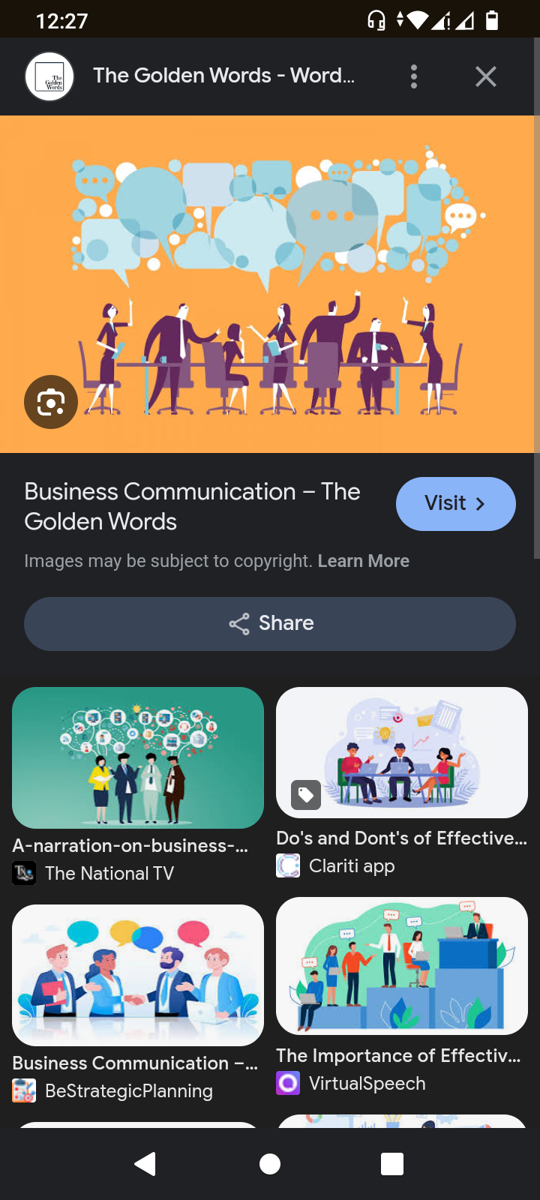
To be Continued...

